Slide 1
2010 Pavement TPR Review

Slide 2
Notes from 2010 Construction Season
Warm Mix Asphalt
Field Quality Control Supervisor
Tack

Slide 3
Warm Mix Asphalt – What is it?
Asphalt concrete
Uses an “additive”* to decrease binder viscosity
Produced at lower production temps
Compacts at lower mix temps
*ODOT uses water injection method only (~2% by binder weight/1.5% vaporizes

Slide 4
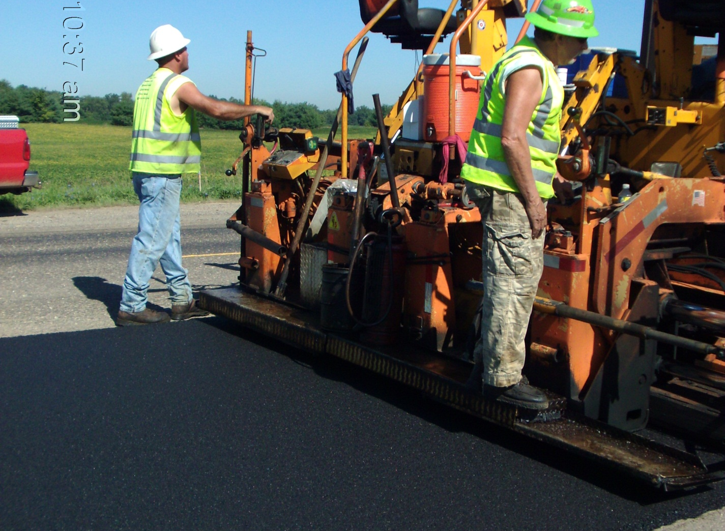
Warm Mix Asphalt – Why use it?
Less stack emissions
Air pollution concerns with greenhouse gasses (CO, CO₂, NO_{x}, SO₂)
Less binder aging
Prematurely aging asphalt using high production temps
Easier Compaction at Lower Mix Temps
Decreased viscosity of binder means ease of compaction

Slide 5
Warm Mix Asphalt - How are we doing?
Long term durability unknown
Current spec in use since 1/16/09
Many contractors using
~35% of asphalt was WMA in 2010
Some field issues
Overcompaction
Bleeding/flushing of binder

Slide 6
Bleeding/Flushing of Binder

Slide 7
Bleeding/Flushing of Binder

Slide 8
Bleeding/Flushing of Binder

Slide 9
Field Quality Control Supervisor
Part of contractor QC for asphalt
Contract requirement
Contractor expected to make changes to fix the problem

Slide 10
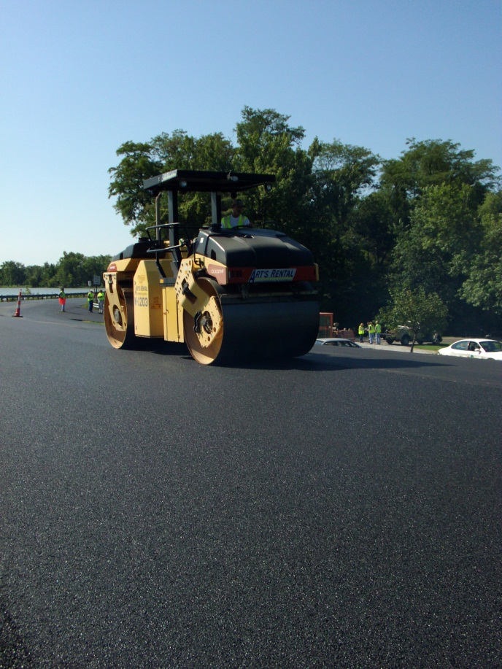
Field Quality Control Supervisor
THIS?
OR THIS?

Slide 11
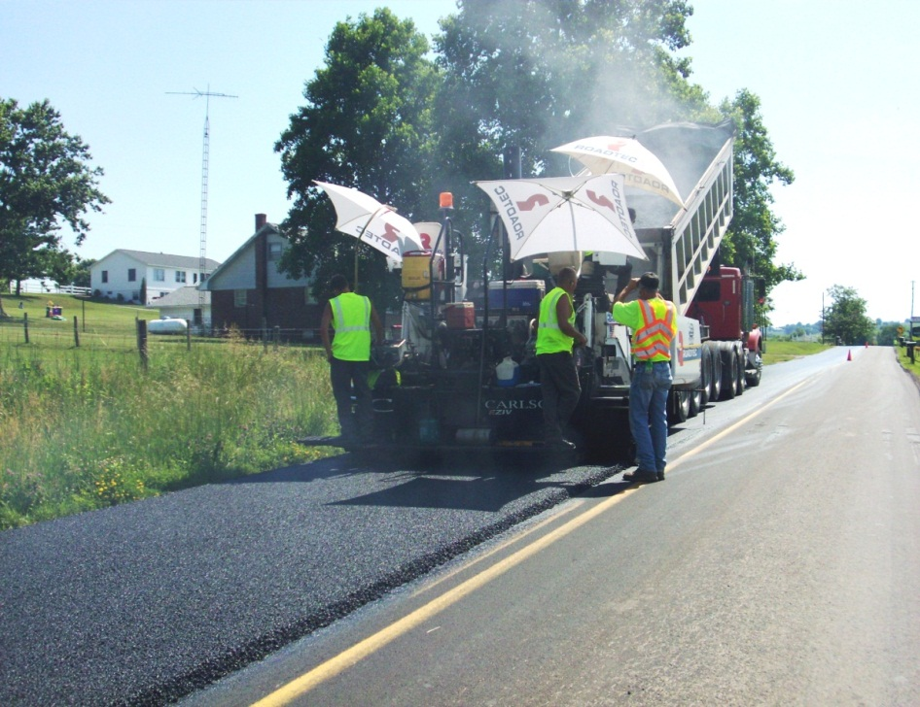
Field Quality Control Supervisor
THIS?
OR THIS?

Slide 12
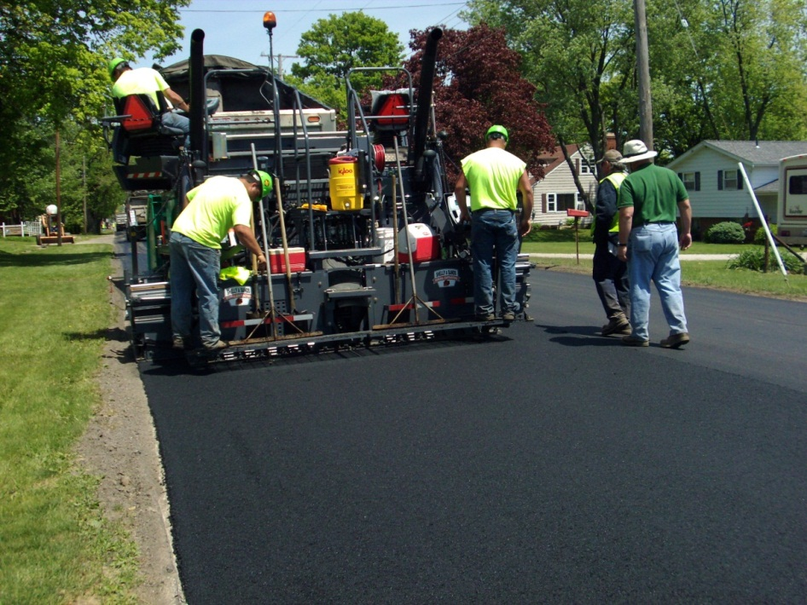
Field Quality Control Supervisor
THIS?
OR THIS?

Slide 13
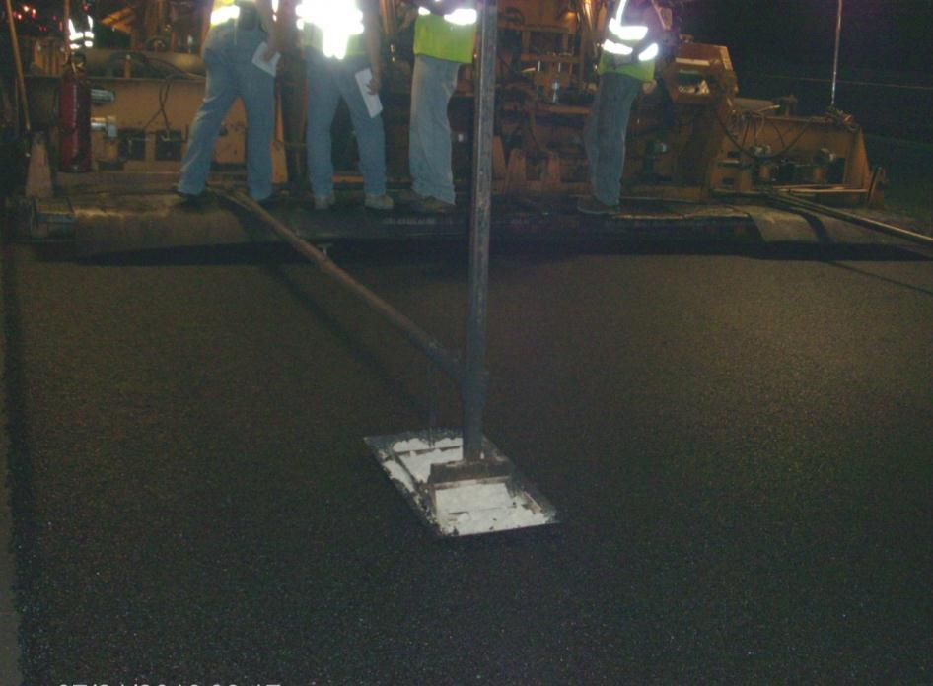
Field Quality Control Supervisor
THIS?
OR THIS?

Slide 14
Tack Redux
Seeing improvement
But lest we forget….

Slide 15
Tack Redux

Slide 16
Thanks – see you in the field

